Slide 1
Highlights
Total Vacancies rate continues to trend lower, reaching 2.6%
Financial and insurance activities, also down drastically from their peak standing at 3.1%
Both sectors have seen significant reductions in vacancy rates since their peaks, caused by the Covid-19 pandemic.
Clearly, lower inflation, which leads the BoE to start its easing cycle, is driving the demand for labor.
Total vacancies continue to decline as more people enter the labor force, driven by business optimism, as lower rates make investment & business projects easier to finance.

Slide 2
Highlights
Total vacancies in the UK continued to trend lower (QoQ) dropping for the 27th consecutive period in July to September 2024
Rising vacancies may indicate labor shortages, where businesses struggle to find qualified workers, or a skills mismatch, leading to inefficiencies. Additionally, high vacancies can reflect economic uncertainty, with companies hesitant to fill positions, contributing to wage inflation and slowing growth. In this context, lower vacancies (green) suggest a healthier market, while higher vacancies (red) signal potential trouble.
*A green-to-red gradient to represent vacancies, where higher vacancies are considered negative, is appropriate when increasing job vacancies signals problems in the labor market or economy.

Slide 3
Highlights
Highlights
Real estate activities saw the largest growth in vacancies, up by 20% YoY
Mining & quarrying showing the steepest drop, down 50% compared to the year-ago period.
Year-over-year (2023 – 2024)*
Most industries experienced a decline in vacancies. Annual growth was positive for only 2 out of the 18 industries year-over-year.
The decline in vacancies across most industries points to a cooling labor market, while growth in real estate and construction suggests continued demand in these sectors.
The cooling labor market keeps Bank of England rate cut on track.

Slide 4
Highlights
Zooming out over a 5-year period, there are more sectors that saw jumps in vacancies
Construction saw the biggest jump in vacancies both total and percentage-wise.
Technological advancements like AI were expected to reduce the demand for human labor in certain sectors, but the rise in labor vacancies over the last five years suggests other factors at play.
This could be due to a shortage of available workers or a mismatch between the skills needed and those present in the labor market.
However, this is not necessarily bad for companies, as AI replacing human labor could improve profit margins and make these firms more competitive.

Slide 5
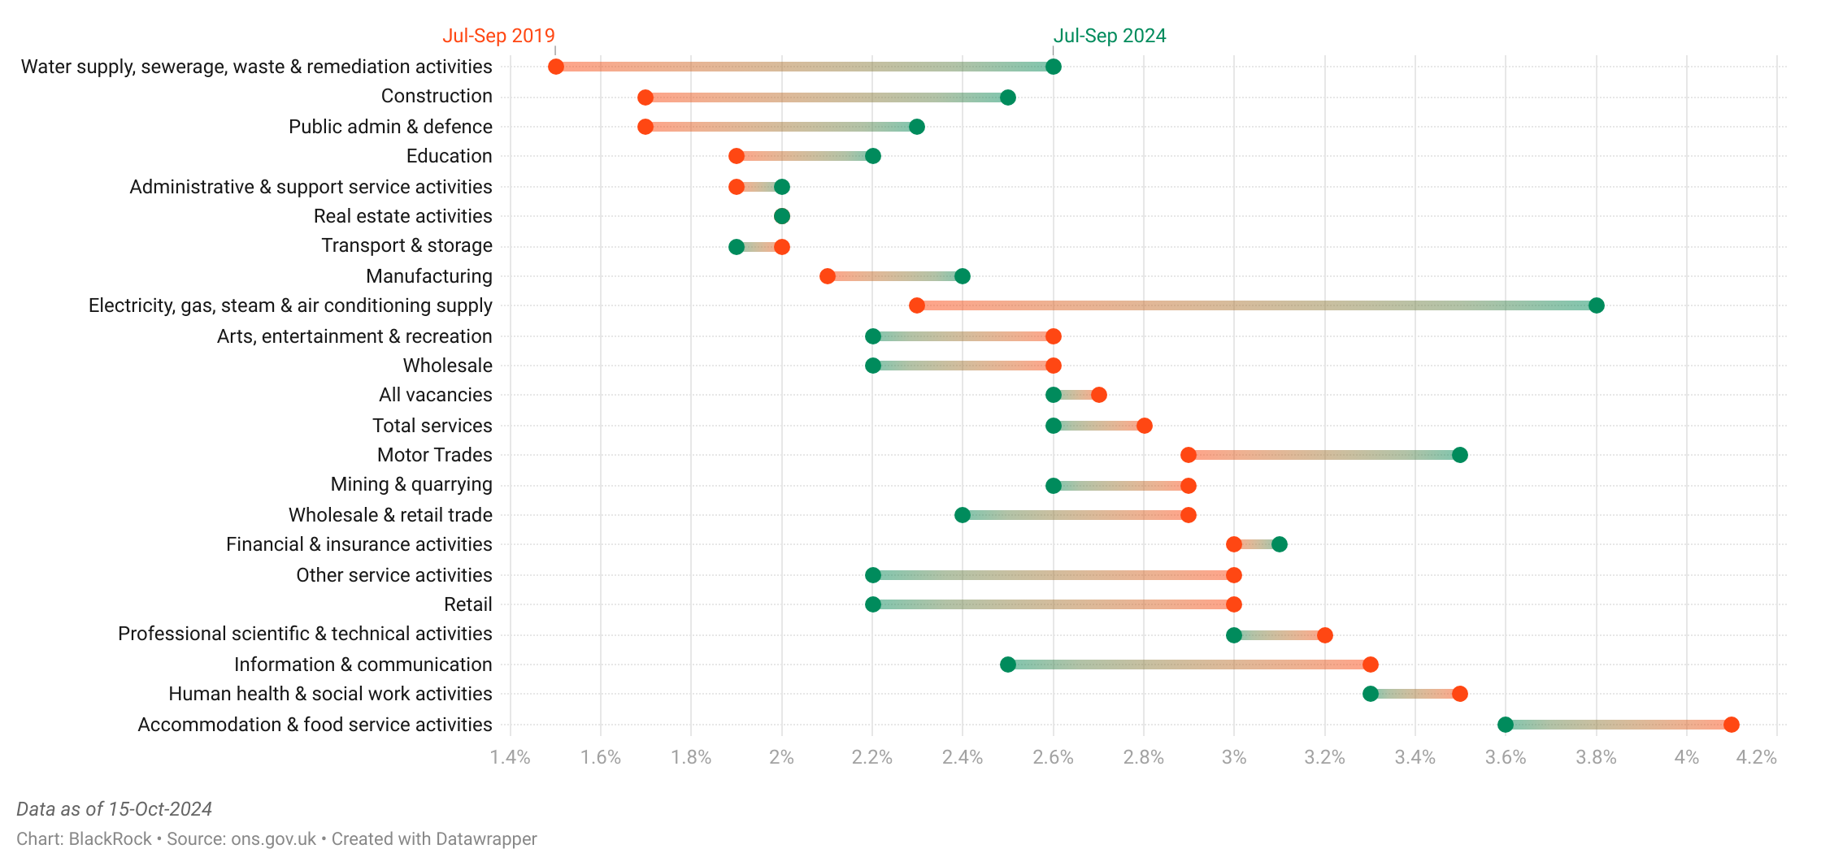
Highlights
"Electricity, gas, steam & air conditioning supply" saw the highest rise in vacancies
"Accommodation & food service activities" experienced the steepest drop in vacancies
UK Vacancies by Industry
5-Year Changes*
* (Jul-Sep 2019 vs Jul-Sep 2024, 3-Month Moving Average)
Looking at a broader period (5-Years) pre-pandemic
Electricity, gas, steam & air conditioning supply saw the biggest increase in vacancies, indicating strong demand for labor in this sector. In contrast, Accommodation & food service activities experienced the largest contraction, reflecting reduced labor demand in the industry. These shifts illustrate diverse trends across different sectors, with some industries facing labor shortages while others see a decline in job openings.

Slide 6
Highlights
Highlights
Electricity, gas, steam & air conditioning supply leads in vacancies, well above the 2.6% average.
Transport & storage and administrative & support services have the lowest vacancy rates

Slide 7
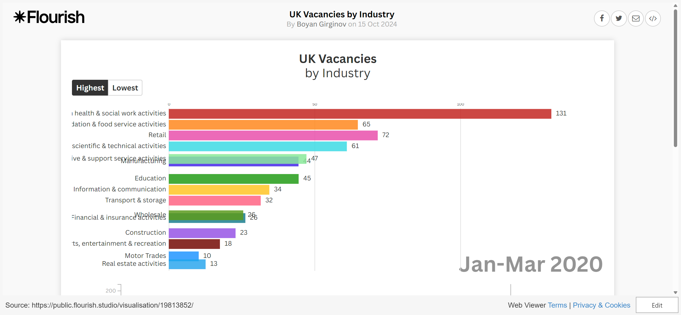
Highlights
Highlights
UK vacancy trends over the past 23 years show significant fluctuations, around major market events.
Sharp drop during COVID-19, followed by a strong rebound and a subsequent decline as the labor market stabilized.

Slide 8
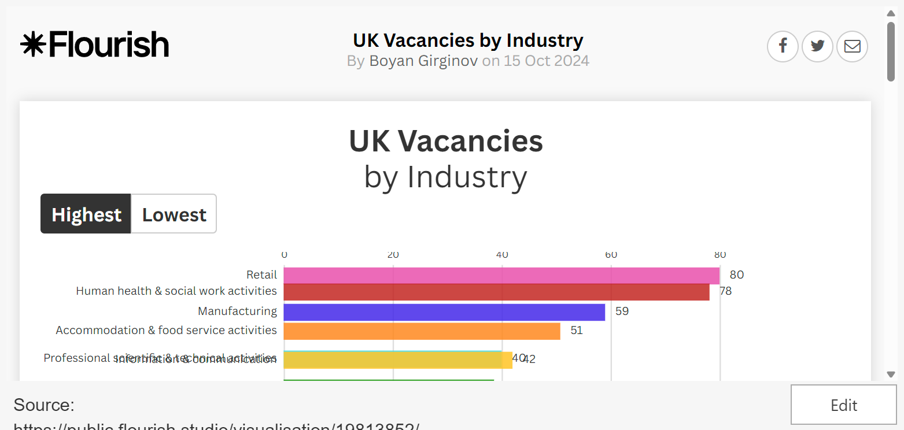
Highlights
Highlights
UK vacancy trends over the past 23 years show significant fluctuations, especially around major events.
Sharp drop during COVID-19, followed by a strong rebound and a subsequent decline as the labor market stabilized.
The big dip in UK vacancy numbers around 2020 corresponds to the onset of the COVID-19 pandemic, when widespread lockdowns, business closures, and economic uncertainty led to a sharp decline in job openings as companies froze hiring.
The subsequent bounce reflects the rapid recovery as restrictions were lifted, businesses reopened, and demand for labor surged, particularly with government support schemes and pent-up demand driving economic activity.
The decline after the peak likely reflects a normalization of the labor market, with demand stabilizing as businesses adjusted to post-pandemic conditions, and factors like inflation, labor shortages, or economic uncertainty cooling.

